Slide 1
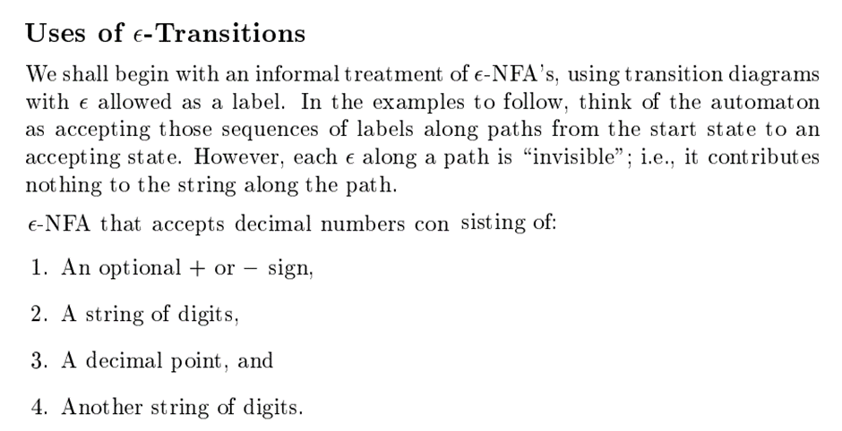
Finite automata with and without epsilon transitions

Slide 2
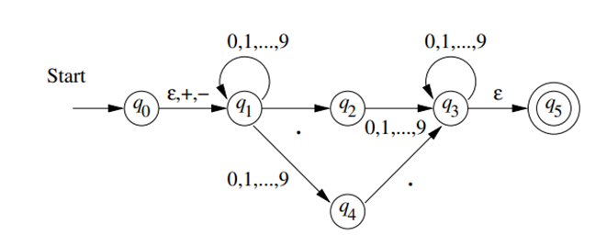
Finite automata with and without epsilon transitions

Slide 3
Finite automata with and without epsilon transitions
Problems
1. Construct є-NFA for accepting the keywords either web or ebay
Construct є-NFA for accepting the keywords either if or for

Slide 4
Finite automata with and without epsilon transitions

Slide 5
Finite automata with and without epsilon transitions

Slide 6
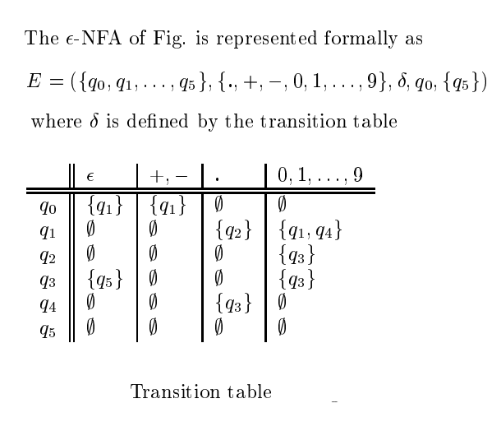
Finite automata with and without epsilon transitions

Slide 7
Epsilon-Closure (є-closure)

Slide 8
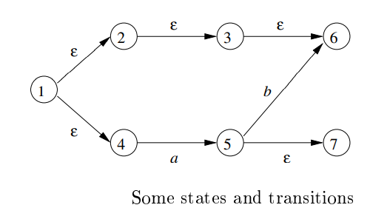
Epsilon-Closure (є-closure)
Є-closure(1)={1,2,3,4,6}
Є-closure(2)=?
Є-closure (3)=?
Є-closure (4)=?
Є-closure (5)=?

Slide 9
Epsilon-Closure (є-closure)
1. ε-closure(q0) = {q0}
2. ε-closure(q1) = {q1, q2}
3. ε-closure(q2) = {q2}

Slide 10
Eliminating є moves in NFA (convert є-NFA to DFA)
Convert the ε -NFA into its equivalent DFA.

Slide 11
Epsilon-Closure (є-closure)
Solution:
Let us obtain ε-closure of each state.
1. ε-closure {q0} = {q0, q1, q2}
2. ε-closure {q1} = {q1}
3. ε-closure {q2} = {q2}
4. ε-closure {q3} = {q3}
5. ε-closure {q4} = {q4}
Now, let ε-closure {q0} = {q0, q1, q2} be state A.
Hence
δ'(A, 0) = ε-closure {δ((q0, q1, q2), 0) }
= ε-closure {δ(q0, 0) ∪ δ(q1, 0) ∪ δ(q2, 0) }
= ε-closure {q3}
= {q3} call it as state B.

Slide 12
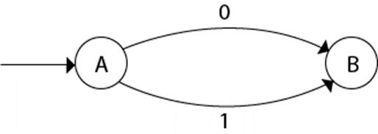
Epsilon-Closure (є-closure)
δ'(A, 1) = ε-closure {δ((q0, q1, q2), 1) }
= ε-closure {δ((q0, 1) ∪ δ(q1, 1) ∪ δ(q2, 1) }
= ε-closure {q3}
= {q3} = B.
The partial DFA will be

Slide 13
Epsilon-Closure (є-closure)
Now,
δ'(B, 0) = ε-closure {δ(q3, 0) }
= ϕ
δ'(B, 1) = ε-closure {δ(q3, 1) }
= ε-closure {q4}
= {q4} i.e. state C
For state C:
1. δ'(C, 0) = ε-closure {δ(q4, 0) }
= ϕ
2. δ'(C, 1) = ε-closure {δ(q4, 1) }
= ϕ

Slide 14
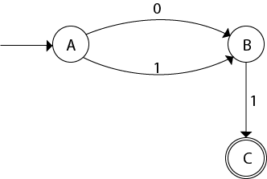
Epsilon-Closure (є-closure)
The DFA will be,

Slide 15
Epsilon-Closure (є-closure)
The DFA will be,

Slide 16
Epsilon-Closure (є-closure)
Example 2: Convert the given NFA into its equivalent DFA.

Slide 17
Epsilon-Closure (є-closure)
Solution: Let us obtain the ε-closure of each state.
1. ε-closure(q0) = {q0, q1, q2}
2. ε-closure(q1) = {q1, q2}
3. ε-closure(q2) = {q2}
Now we will obtain δ' transition. Let ε-closure(q0) = {q0, q1, q2} call it as state A.
δ'(A, 0) = ε-closure{δ((q0, q1, q2), 0)}
= ε-closure{δ(q0, 0) ∪ δ(q1, 0) ∪ δ(q2, 0)}
= ε-closure{q0}
= {q0, q1, q2}
δ'(A, 1) = ε-closure{δ((q0, q1, q2), 1)}
= ε-closure{δ(q0, 1) ∪ δ(q1, 1) ∪ δ(q2, 1)}
= ε-closure{q1}
= {q1, q2} call it as state B

Slide 18
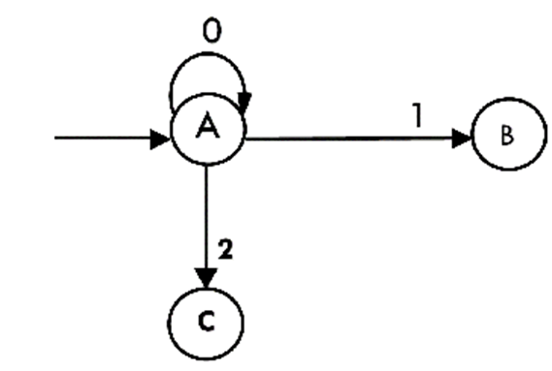
Epsilon-Closure (є-closure)
δ'(A, 2) = ε-closure{δ((q0, q1, q2), 2)}
= ε-closure{δ(q0, 2) ∪ δ(q1, 2) ∪ δ(q2, 2)}
= ε-closure{q2}
= {q2} call it state C
Thus we have obtained
1. δ'(A, 0) = A
2. δ'(A, 1) = B
3. δ'(A, 2) = C
The partial DFA will be:

Slide 19
Epsilon-Closure (є-closure)
Now we will find the transitions on states B and C for each input.
Hence
δ'(B, 0) = ε-closure{δ((q1, q2), 0)}
= ε-closure{δ(q1, 0) ∪ δ(q2, 0)}
= ε-closure{ϕ}
= ϕ
δ'(B, 1) = ε-closure{δ((q1, q2), 1)}
= ε-closure{δ(q1, 1) ∪ δ(q2, 1)}
= ε-closure{q1}
= {q1, q2} i.e. state B itself
δ'(B, 2) = ε-closure{δ((q1, q2), 2)}
= ε-closure{δ(q1, 2) ∪ δ(q2, 2)}
= ε-closure{q2}
= {q2} i.e. state C itself

Slide 20
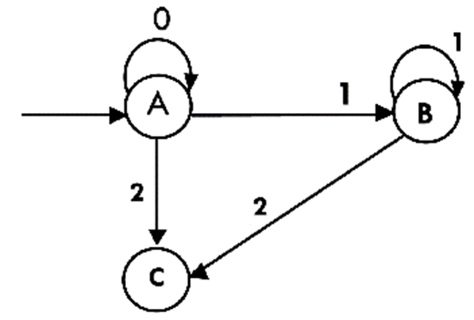
Epsilon-Closure (є-closure)
Thus we have obtained
1. δ'(B, 0) = ϕ
2. δ'(B, 1) = B
3. δ'(B, 2) = C
The partial transition diagram will be

Slide 21
Epsilon-Closure (є-closure)
Now we will obtain transitions for C:
δ'(C, 0) = ε-closure{δ(q2, 0)}
= ε-closure{ϕ}
= ϕ
δ'(C, 1) = ε-closure{δ(q2, 1)}
= ε-closure{ϕ}
= ϕ
δ'(C, 2) = ε-closure{δ(q2, 2)}
= {q2}
Hence the DFA is

Slide 22
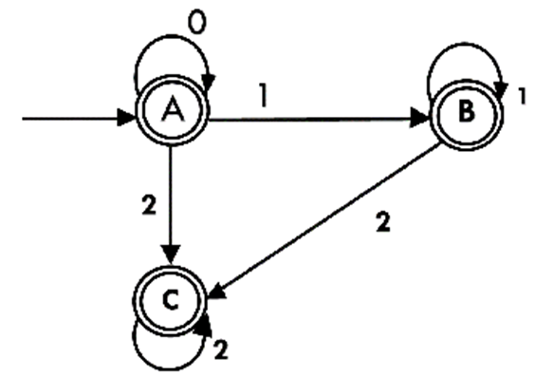
Epsilon-Closure (є-closure)
As A = {q0, q1, q2} in which final state q2 lies hence A is final state. B = {q1, q2} in which the state q2 lies hence B is also final state. C = {q2}, the state q2 lies hence C is also a final state.

Slide 23
Epsilon-Closure (є-closure)

Slide 24
Epsilon-Closure (є-closure)

